Slide 1
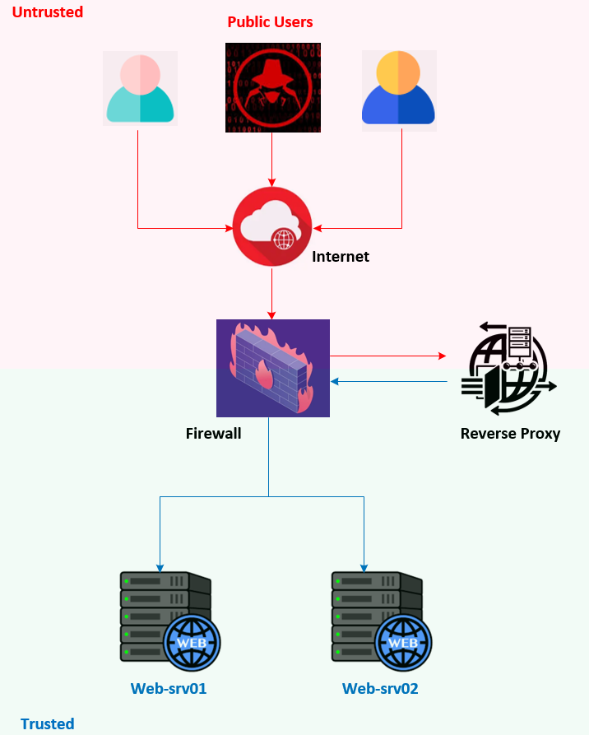

F5 LTM Learning with Alexander S
Chapter 03 – The Need for a Reverse Proxy: Focusing on Load Balancing and Security

Slide 2
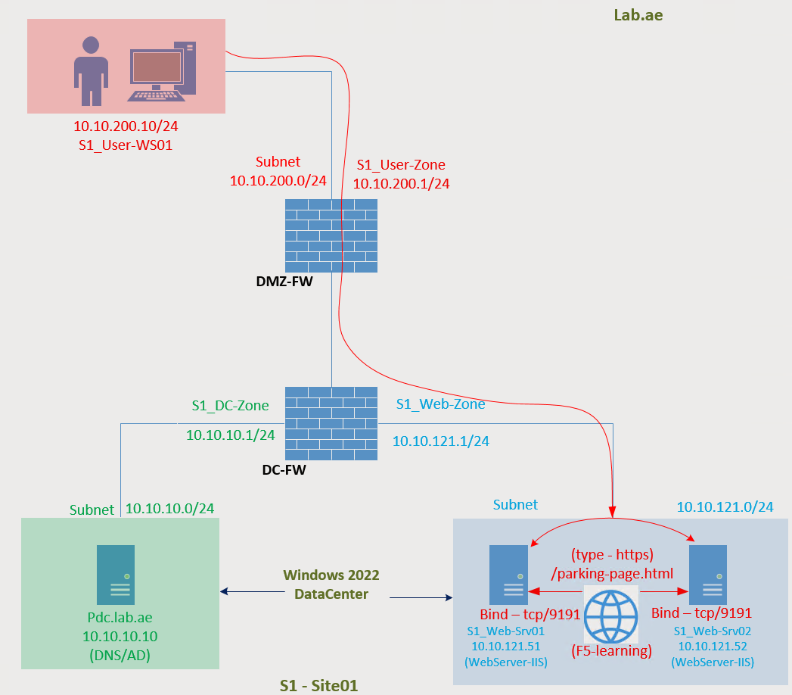
The web application is accessible from the client machine
User-Zone
Subnet : 10.10.200.0/24
Gateway : 10.10.200.1
User-WS01 : 10.10.200.10

Slide 3
Why do we need a load balancer?
Let the users continue to access the same way!!
Is that fine?

Slide 4
Service failure on Web-Srv01 – Creates the impact to users
Web-Srv01 is down due to technical reason.
Unfortunately, user access that server without knowing the availability.
User got impacted.

Slide 5
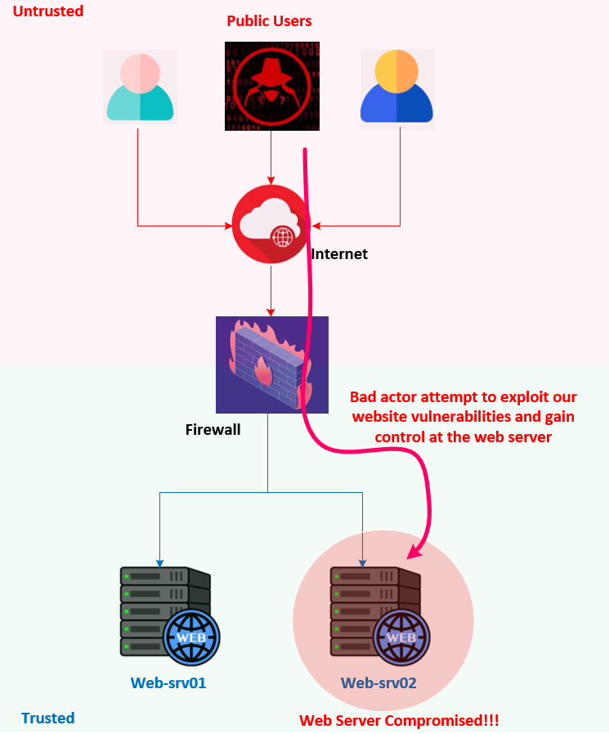
Bad actor - Exploit our website vulnerabilities and gain the control at web server
Web site is available for public.
It’s not only legitimate users who access our website.
May be bad actors also access our website.
Assume one of the bad actor attempt to exploit our website vulnerabilities and gain control at the web server operating system level.
This will put the organization into big risk!!!

Slide 6
Need a solution for – Service Failure & Protect the website from Bad actor

Slide 7
Proxy - The middle-man sits between a client and a destination server
It receives and validates client requests to check if they are legitimate or malicious.
If it is not legitimate the middleman should block the request.
If it is legitimate, then forwards the client request to one of the available web servers
Also, It should receive the response from the server
Then returns the response back to the client.

Slide 8
Reverse proxy - Act on behalf of the servers to protect them from bad actors
we are providing the web service to the public from our web servers. So, the web servers are trusted.
Anyone can access the website from the public, so the users are untrusted.
Therefore, the proxy should act on behalf of the servers to protect them from bad actors.
This type of proxy is called a reverse proxy.

Slide 9
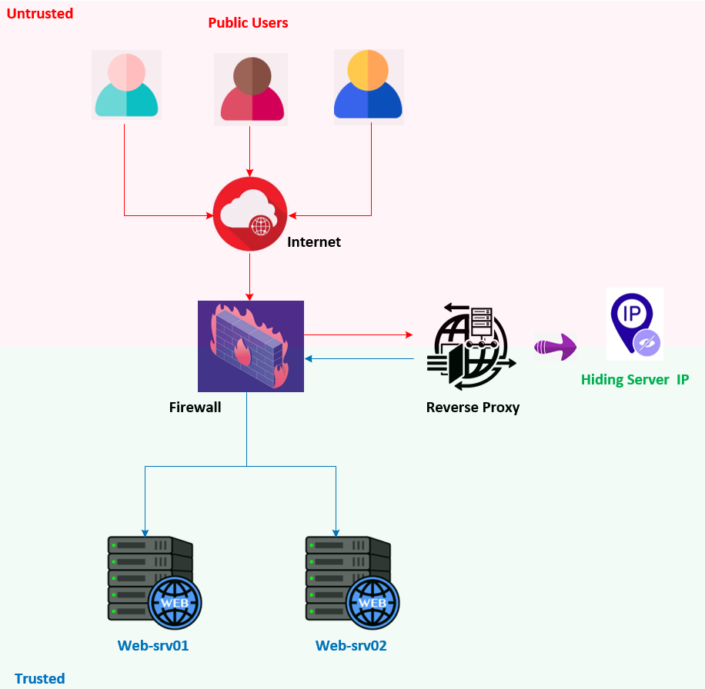
Reverse Proxy - Hides the backend server
A reverse proxy hides backend server details from the internet.
This adds extra layer of security by masking internal infrastructure.

Slide 10
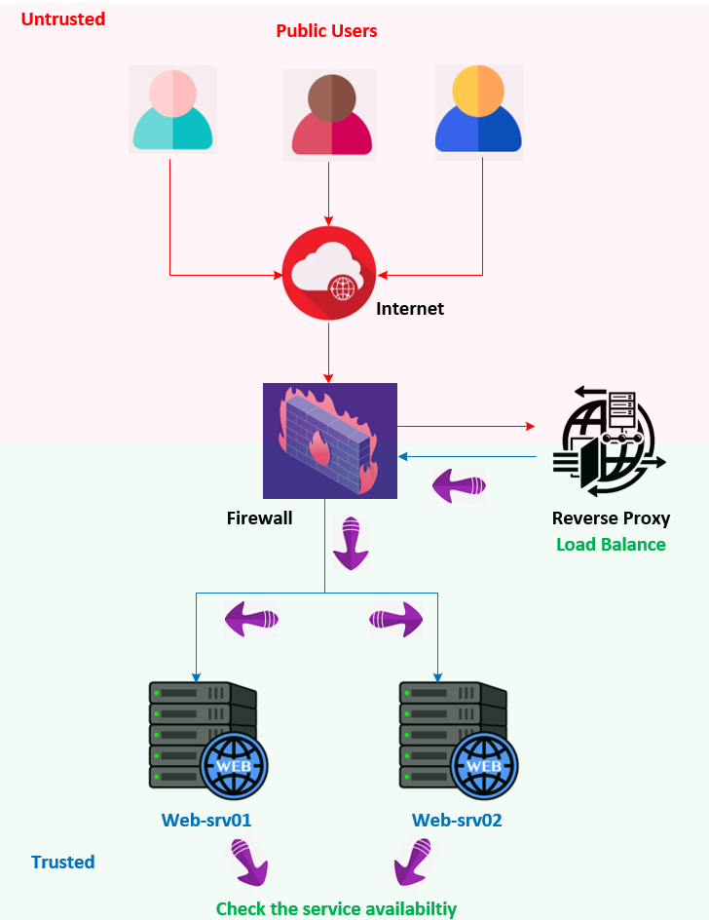
Reverse Proxy – Load balance incoming traffic after checking the service availability
A reverse proxy distributes incoming traffic across multiple backend servers for load balancing, after checking service availability.

Slide 11
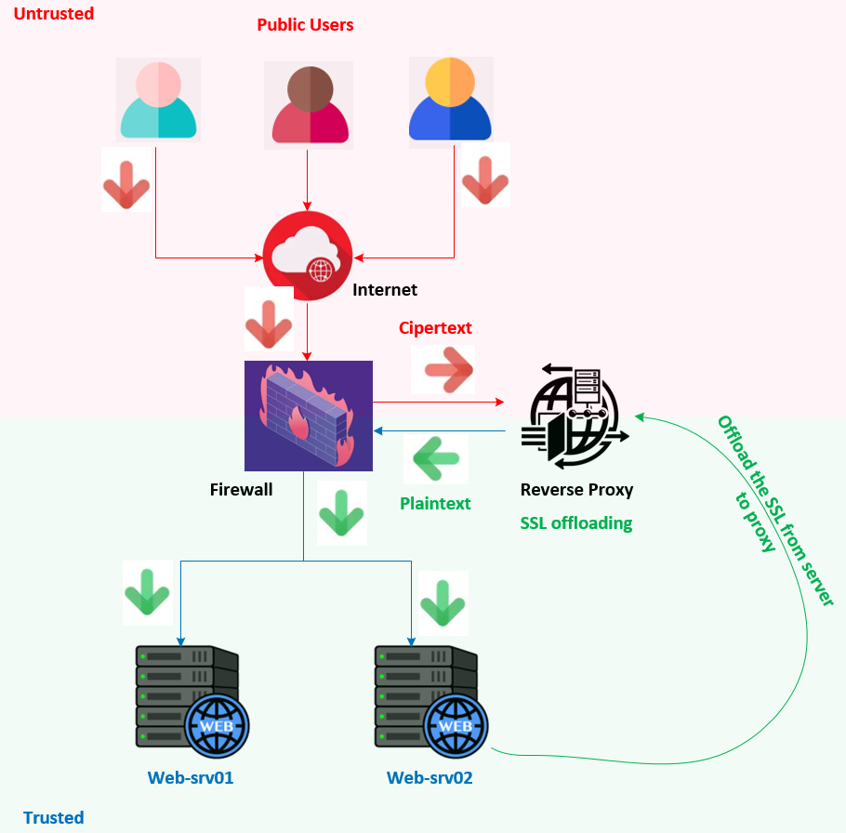
Reverse Proxy – Offloads SSL from web server
A reverse proxy offloads HTTPS decryption from backend servers through SSL termination.
From client to Reverse Proxy SSL.
From Reverse Proxy to backend Server plain text.

Slide 12
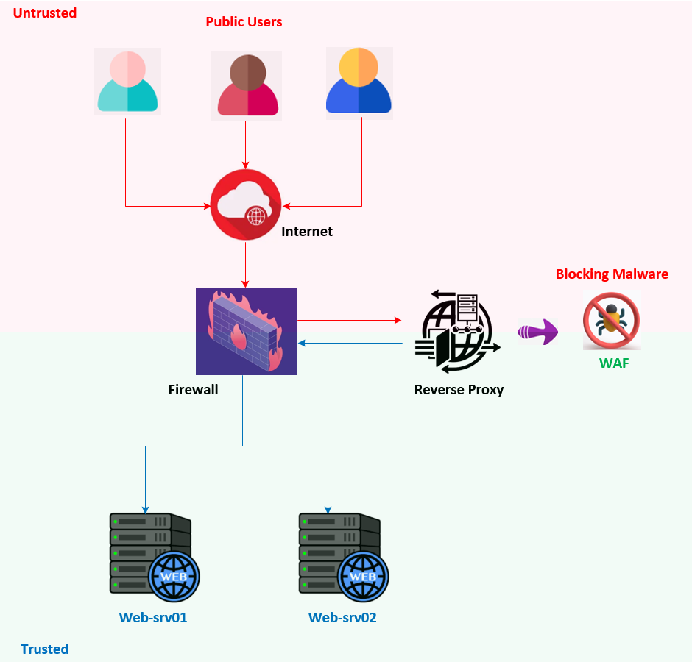
Reverse Proxy – Block the malicious traffic by acting as WAF
A reverse proxy filters malicious traffic by acting as a Web Application Firewall (WAF),
This preventing harmful requests from reaching the backend servers.

Slide 13
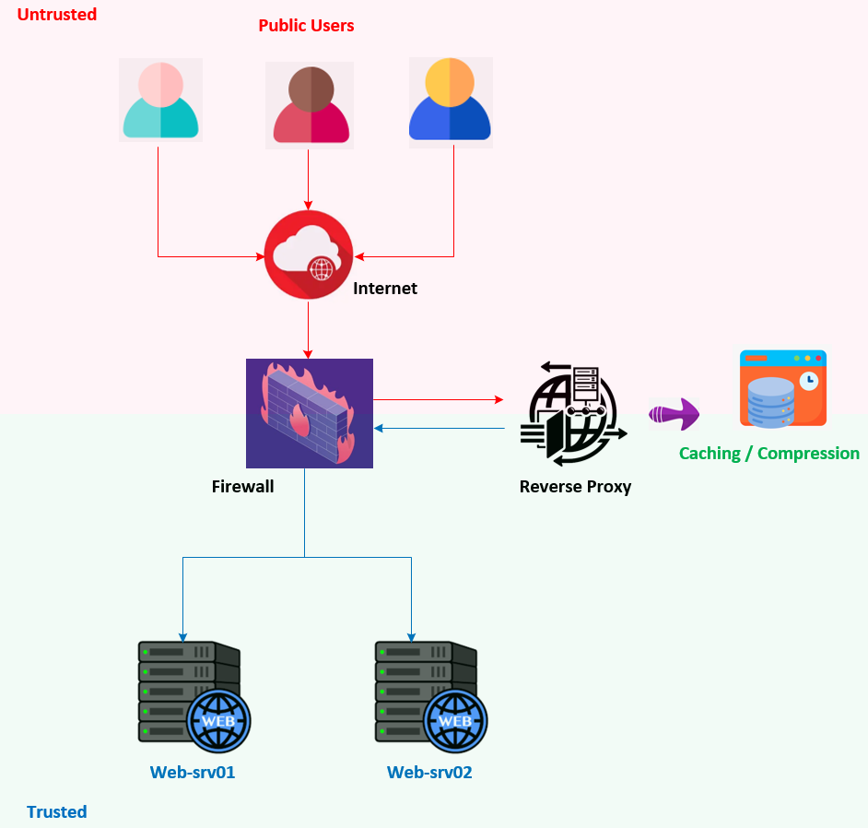
Reverse Proxy – Caching and compression technique improves web application access performance
A reverse proxy uses caching and compression to improve performance and reduce the load on backend servers.

Slide 14
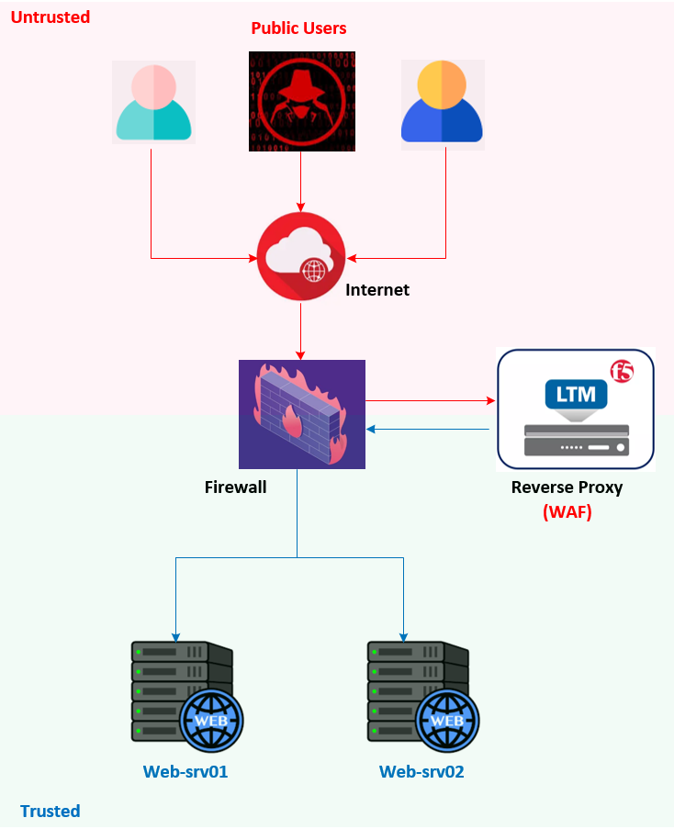
Reverse Proxy – F5 LTM deployed as Reverse Proxy
F5 LTM deployed as reverse proxy and WAF

Slide 15
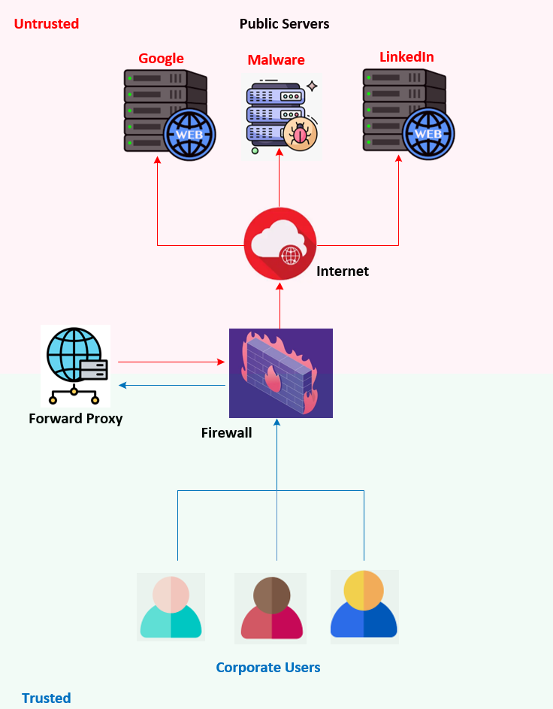
Let us understand forward proxy
Assume a case where an organization has 1,000 users accessing the internet. They can download harmful files from the internet, right?
Which could put the organization in trouble.
Here, the clients are corporate users, and they are trusted.
They are downloading files from the internet, so the destination servers are untrusted.
Therefore, a forward proxy acts on behalf of the client to protect them from unwanted access and downloads.

Slide 16
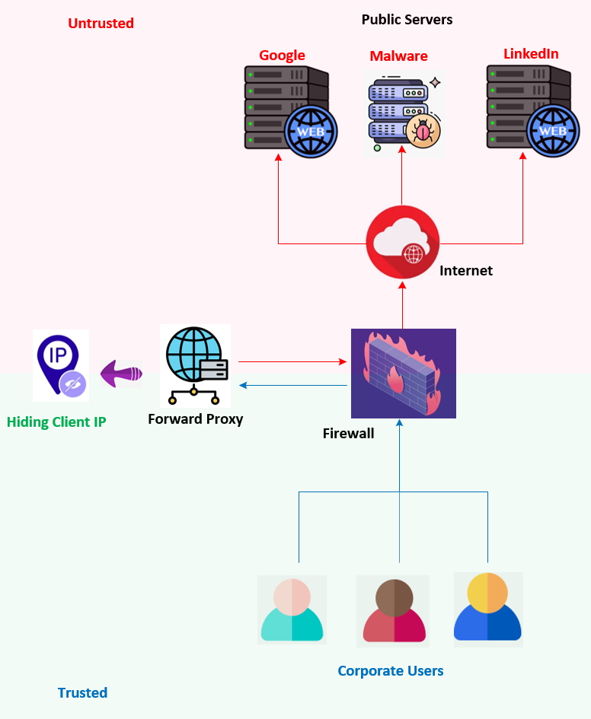
Forward Proxy - Hides the client’s IP address from the internet
A forward proxy hides the client’s IP address from the internet.
This adds extra layer of security by masking internal infrastructure.

Slide 17
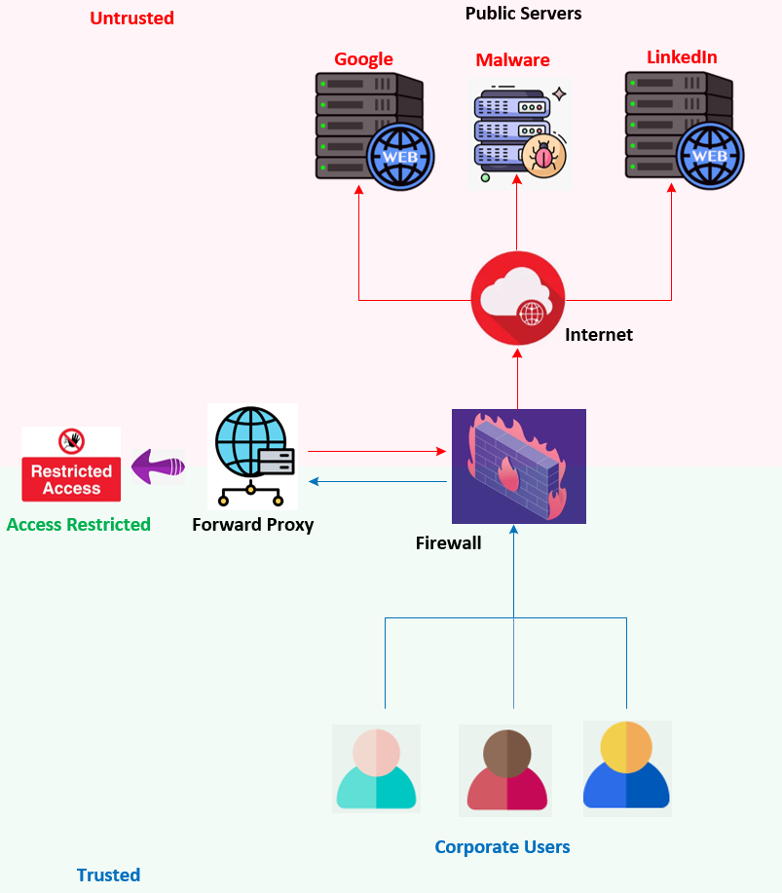
Forward Proxy - Restricts users from accessing specific websites
A forward proxy restricts users from accessing specific websites, allowing or denying access based on defined requirements.

Slide 18
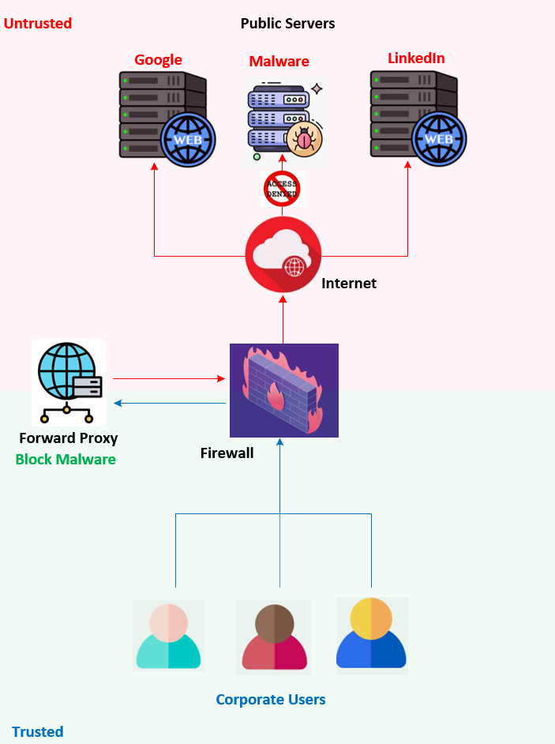
Forward Proxy - Blocks access to malicious sites
A forward proxy blocks access to malicious sites.
Improving infrastructure security by preventing users from downloading harmful files from the internet.

Slide 19
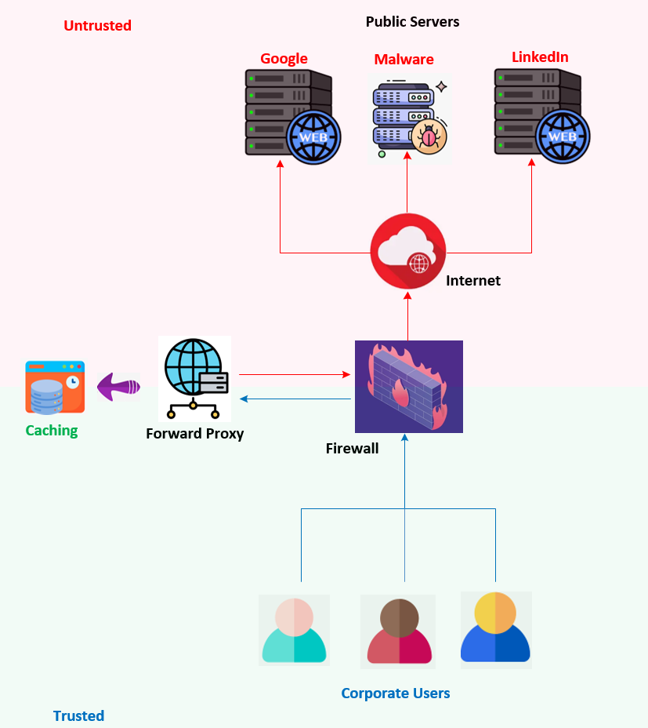
Forward Proxy - Uses caching to reduce bandwidth usage and improve access speed
A forward proxy uses caching to reduce bandwidth usage and improve access speed.

Slide 20
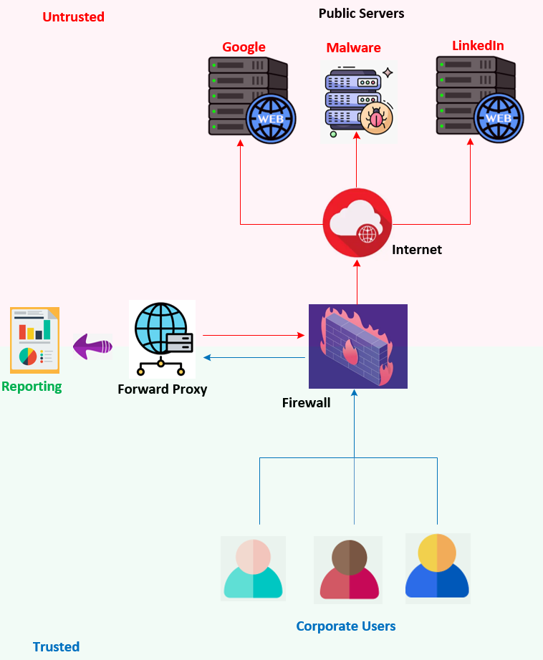
Forward Proxy - Provides visibility on user internet access
A forward proxy provides logging and monitoring features to track user behaviour and network activity.

Slide 21
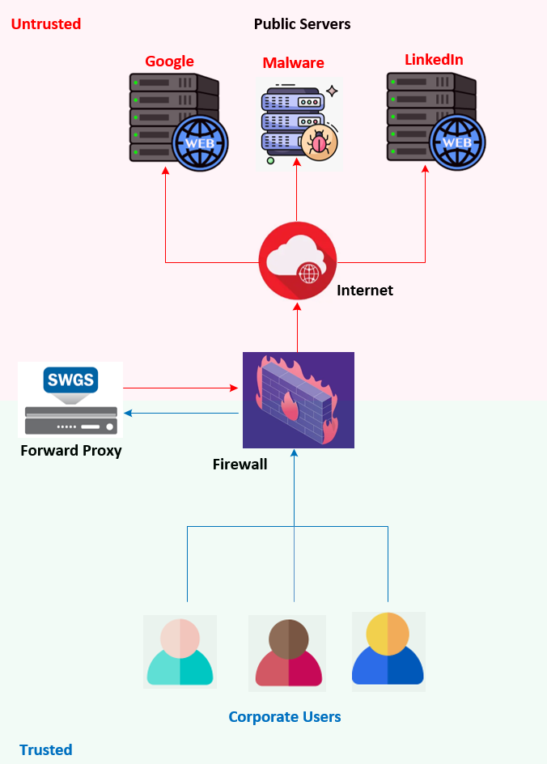
Forward Proxy - F5 SWG deployed as forward proxy
F5 SWG deployed as forward proxy

Slide 22
Summary - Two main types of proxies based on traffic direction

Slide 23
This concludes Chapter 3. Please continue watching Chapter 4 to understand how the F5 LTM operates as a full reverse proxy. Thank you for watching!
Chapter 03 – The Need for a Reverse Proxy: Focusing on Load Balancing and Security

